Slide 1
Secure Data Hiding in Image Using Steganography
CAPSTONE PROJECT
Presented By: Amanpreet Kaur Saini
Student Name : Amanpreet Kaur Saini
College Name : Institute of Informatics and Communication ,University of Delhi
Department : Informatics

Slide 2
Problem Statement
Traditional methods of data security, such as encryption, can raise suspicion when intercepted.
Steganography provides a way to hide sensitive data within images, making it less detectable.
This project ensures secure data transmission by embedding secret messages into images using pixel manipulation.
Only users with the correct passcode can extract and decrypt the hidden message.

Slide 3
OUTLINE
Problem Statement
Technology used
Wow factor
End users
Result
Conclusion
Git-hub Link
Future scope

Slide 4
Technology used
Programming Language: Python
IDE: Visual Studio Code
Libraries Used:
OpenCV (cv2) – for image processing
OS – for file handling
String manipulation techniques for encoding and decoding
Concept: Image Steganography (Pixel-based encryption)
Platform: Windows 11

Slide 5
Wow factors
Uses steganography to store secret messages inside an image.
Ensures data security through passcode-protected decryption.
Uses an image as a carrier, making hidden messages less detectable.
Simple and lightweight implementation with Python.
The encryption process does not significantly alter the visible image.

Slide 6
End users
Cybersecurity professionals
Government agencies for secure communication
Journalists and whistleblowers for confidential information sharing
Individuals who require private and secure message transmission

Slide 7
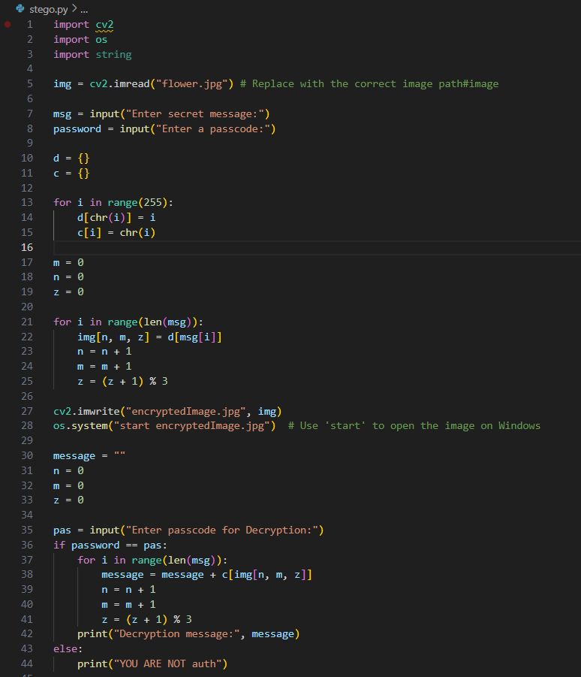


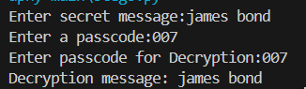
Results
Original Image | Encrypted Image
Output

Slide 8
Conclusion
This project demonstrates a simple yet effective method of hiding sensitive data within images.
By using pixel-based steganography, we ensure message confidentiality while keeping the image visually unchanged.
Passcode authentication adds an extra layer of security to prevent unauthorized access.

Slide 9
GitHub Link
https://github.com/sainiaman20/aicte_stego.git

Slide 10
Future scope(optional)
Implementing more advanced steganographic techniques such as LSB (Least Significant Bit) replacement for better security.
Enhancing security with cryptographic algorithms before embedding messages.
AI-based Detection Prevention- Ensuring messages stay undetectable from modern forensic tools.
Mobile App & Web Version -Expanding accessibility beyond desktops.

Slide 11
THANK YOU

